Slide 1
Cellular and Mobile Wireless Networks
Advanced Computer Networks

Slide 2
Cellular/Mobile Wireless Outline
Cellular Architecture
Cellular Standards
GSM, 2G, 2.5G, 3G and 4G LTE
Mobile Definitions
Agents, addresses, correspondent
Mobile Architecture
Registering
Indirect Routing
Direct Routing

Slide 3

Cellular Network Architecture
MSC
connects cells to wide area net
manages call setup
handles mobility
cell
covers geographical region
base station (BS) analogous to 802.11 AP
mobile users attach to network through BS
air-interface: physical and link layer protocol between mobile and BS
Mobile
Switching
Center
Public telephone
network, and
Internet
Mobile
Switching
Center
wired network

Slide 4
Cellular Networks: The First Hop
Two techniques for sharing mobile-to-BS radio spectrum:
combined FDM/TDM: divide spectrum in frequency channels, divide each channel into time slots.
CDMA: Code Division Multiple Access
Global System for Mobile Communications (GSM):
200 kHz frequency bands
Each band supports 8 TDM calls.
Speech encoded at 12.2 and 13 kbps.
time slots
frequency
bands

Slide 5
Cellular Standards: Brief Survey
2G Systems: voice channels/digital technology
IS-136 TDMA: combined FDM/TDM (North America)
GSM (Global System for Mobile Communications): combined FDM/TDM
most widely deployed **
IS-95 CDMA: Code Division Multiple Access
CDMA-2000
TDMA/FDMA
GPRS
EDGE
UMTS
Don’t drown in a bowl
of alphabet soup: use this
for reference only
IS-136
GSM
IS-95

Slide 6
2G Network Architecture
Base station system (BSS)
MSC
BTS
BSC
G
Public
telephone
network
Gateway
MSC
Legend
Base transceiver station (BTS)
Base station controller (BSC)
2G: Voice Connections to the
Telephone Company
Mobile Switching Center (MSC)
Mobile subscribers

Slide 7
Cellular Standards: 2.5G
2.5G systems: voice and data channels
{For those who could not wait for 3G service}
Provide 2G extensions:
General Packet Radio Service (GPRS)
evolved from GSM.
data sent dynamically on multiple channels (if available).
Data rates up to 115 Kbps.
Enhanced Data Rates for Global Evolution (EDGE)
also evolved from GSM, using enhanced modulation.
data rates up to 384 Kbps.
CDMA-2000 (phase 1)
data rates up to 144 Kbps.
evolved from IS-95.

Slide 8
2.5G Network Architecture
MSC
BSC
G
Public
telephone
network
Gateway
MSC
2.5G Voice-Data Network
Key insight: new cellular data
network operates in parallel
(except at edge) with existing
cellular voice network.
voice network is unchanged in core.
data network operates in parallel.
G
Public
Internet
SGSN
GGSN
Serving GPRS Support Node (SGSN)
Gateway GPRS Support Node (GGSN)

Slide 9
3G (Voice+Data) Network Architecture
MSC
G
Public
telephone
network
radio
network
controller
Gateway
MSC
G
Public
Internet
SGSN
Key insight: new cellular data
network operates in parallel
(except at edge) with existing
cellular voice network
voice network unchanged in core
data network operates in parallel
GGSN
Serving GPRS Support Node (SGSN)
Gateway GPRS Support Node (GGSN)

Slide 10
3G (Voice+Data) Network Architecture
MSC
G
Public
telephone
network
radio
network
controller
Gateway
MSC
G
Public
Internet
SGSN
GGSN
radio interface
(WCDMA, HSPA)
radio access network
Universal Terrestrial Radio
Access Network (UTRAN)
core network
General Packet Radio Service
(GPRS) Core Network
public
Internet

Slide 11
Cellular Standards: 3G
3G systems: voice/data
Two technologies:
1. Universal Mobile Telecommunications Service (UMTS)
Leaves the existing 2.5G system in place.
data service: High Speed Downlink/Uplink Packet Access (HSDPA/HSUPA) up to 14 Mbps.

Slide 12
Cellular Standards: 3G
2. CDMA-2000: CDMA in TDMA slots
data service: 1xEVolution Data Optimized (1xEVDO) up to 14 Mbps (Rev B – latest version)
DL layer = Several sub-layers
Practical capacity 3.1 Mbps
1.67 ms slots 16 slots per frame
Wireless AT sends DRC indicator back to BS to dynamically adjust sending rate within the slot
Proportional Fair Scheduler
Uses ‘turbo code’ FEC on multiple slots with ‘early
completion’. Note – redundancy is on the same channel.
Multipath fading hurts EVDO performance across a single channel.

Slide 13
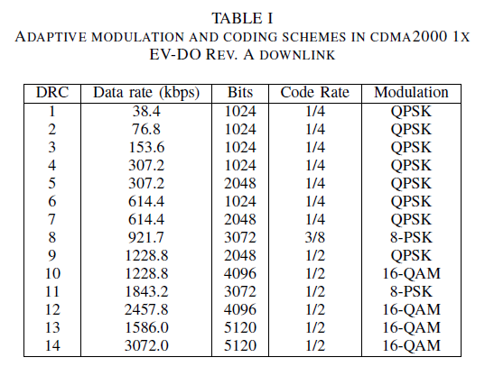
EVDO DRC Table

Slide 14
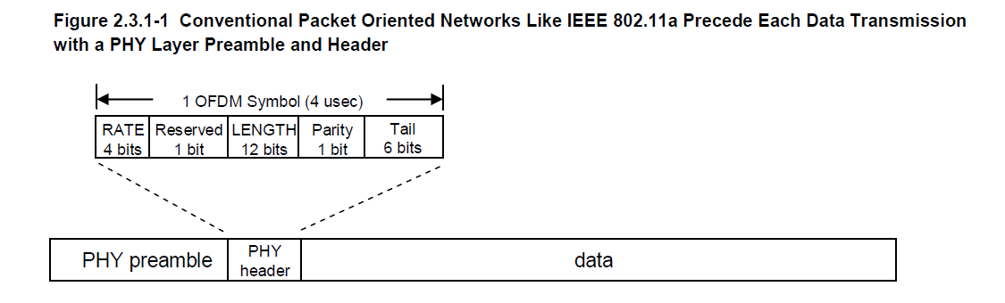
OFDM in IEEE802.11a
PHY preamble is 20 microsec.
Real-world efficiency is about 50%.
Randomized CSMA backoff period represents idle time.
Freescale

Slide 15
3GPP LTE (Long Term Evolution)
4G LTE == 3GPP LTE
Uses OFDM on downlink in cellular space. Uplink is SC-FDMA (Singular Carrier).
Has a CP (cyclic prefix) to avoid symbol distortion over a ‘slot’.
LTE frames (10 msec) are divided into 10 1msec subframes which in turn are divided into 2 two slots (0.5 msec).

Slide 16
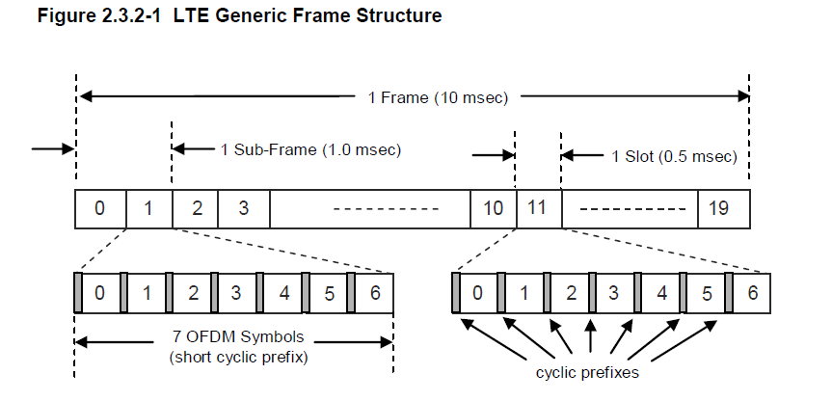
LTE Frame Structure
Freescale
Slots consist of 6 or 7 ODFM symbols.

Slide 17
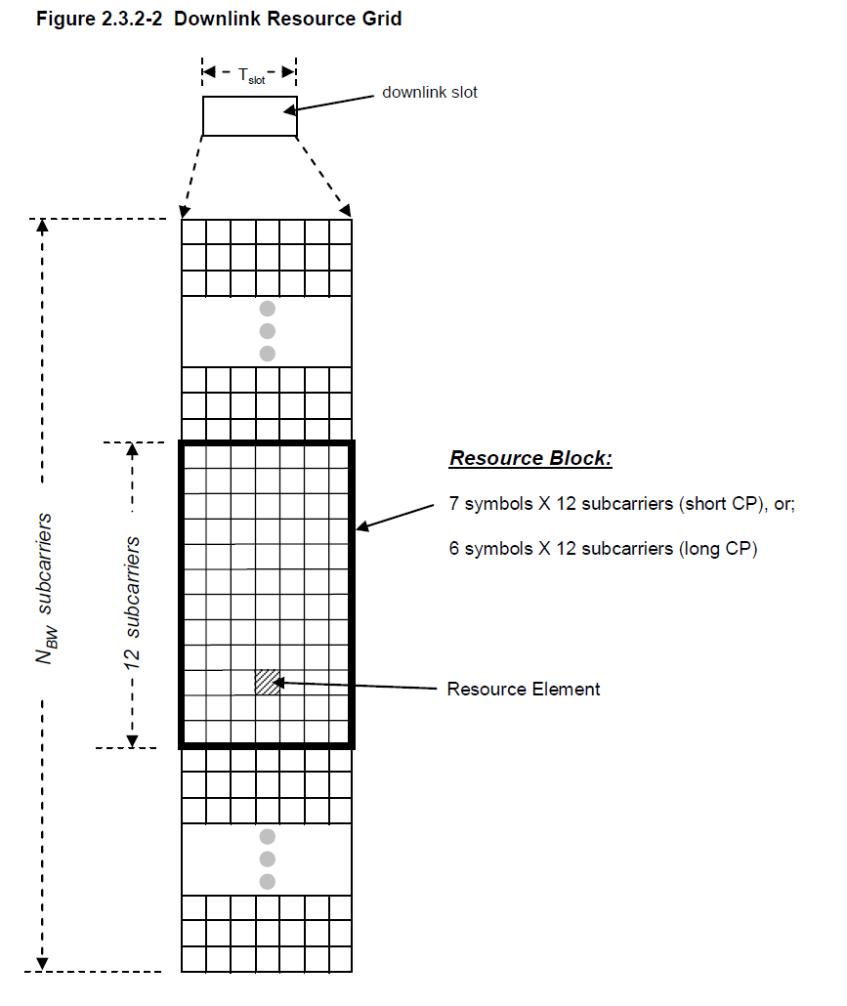
LTE Physical Resource Block (PRB)
OFDMA allocates a PRB (Physical Resource Block) to users.
A PRB consists of 12 consecutive subcarriers (15 kHz bandwidth) for one slot.
PRB is then (6 or 7) symbols x 12 subcarriers.
Freescale

Slide 18
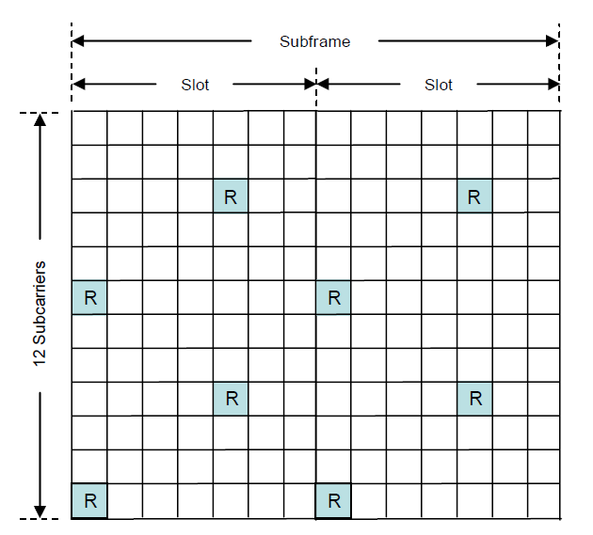
LTE Reference Symbols
Instead of PHY preambles (802.11), reference symbols are embedded in the PRB.
LTE also employs MIMO.
Freescale

Slide 19
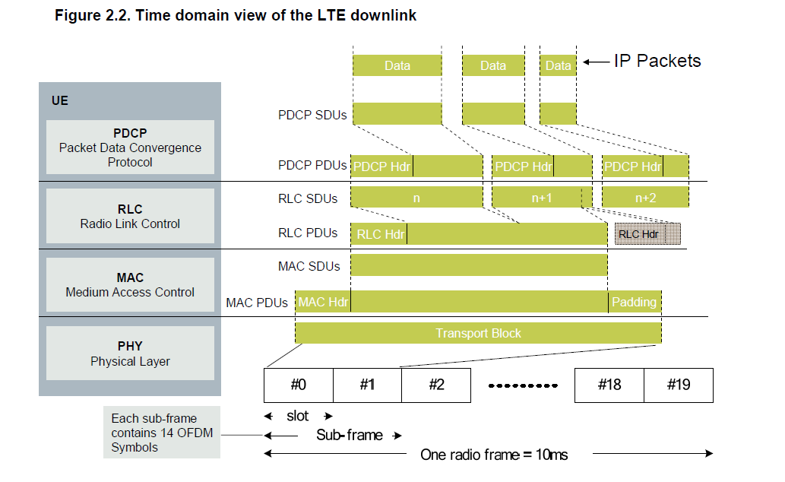
LTE Layer 2
Freescale

Slide 20
Mobile Wireless Networks
Advanced Computer Networks

Slide 21
What is Mobility?
Spectrum of mobility, from the network layer
perspective:
no mobility
high mobility
User only moves within
the same wireless
access network.
User moves between access networks, disconnecting while between networks.
User passes through multiple access networks while maintaining ongoing connections (like cell phone).

Slide 22
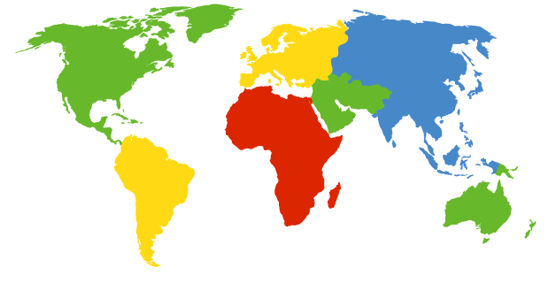


Human Analogy: How to Contact a Mobile Friend ?
Consider a friend frequently changing residence addresses. How do you find her?
I wonder where Alice moved to?
Search all phone books?
Call her parents or her friends?
Expect her to let you know where he/she now lives?

Slide 23
Mobile Network Architecture
Home network: permanent “home” of mobile
(e.g., 128.119.40/24)
Home agent: entity that will perform mobility functions on behalf of mobile, when mobile is remote.
wide area network
Permanent address: address in home network, can always be used to reach mobile.
e.g., 128.119.40.186
Correspondent: wants to communicate with mobile node.

Slide 24
More Mobility Vocabulary
Visited network: network in which mobile currently resides (e.g., 79.129.13/24)
Permanent address: remains constant (e.g., 128.119.40.186)
Care-of-address: address in visited network.
(e.g., 79.129.13.2)
wide area network
Foreign agent: entity in visited network that performs mobility functions on behalf of mobile.
Correspondent

Slide 25
Mobility Approaches
Let routing handle it: Routers advertise permanent address of mobile-nodes-in-residence via usual routing table exchange.
routing tables indicate where each mobile node is located.
no changes to end-systems.
Let end-systems handle it:
indirect routing: communication from correspondent to mobile node goes through home agent, then forwarded to remote network.
direct routing: correspondent gets foreign address of mobile node, sends directly to mobile node.

Slide 26
Mobility Approaches
Let routing handle it: Routers advertise permanent address of mobile-nodes-in-residence via usual routing table exchange.
routing tables indicate where each mobile node is located.
no changes to end-systems
Let end-systems handle it:
indirect routing: communication from correspondent to mobile node goes through home agent, then forwarded to remote network.
direct routing: correspondent gets foreign address of mobile node, sends directly to mobile node.
not
scalable
to millions of
mobiles

Slide 27
Mobility Registration
Visited network
Home network
1
2
wide area network
Mobile node contacts foreign agent upon entering visited network.
Foreign agent contacts home agent home: “This mobile node is resident in my network”.
End result:
Foreign agent knows about mobile node.
Home agent knows location of mobile node.

Slide 28
Mobility via Indirect Routing
Home agent intercepts packets, forwards to foreign agent.
Foreign agent receives packets, forwards to mobile node.
Home
network
Visited
network
2
3
wide area network
1
Correspondent addresses packets using home address of mobile node.
4
Mobile node replies directly to correspondent.

Slide 29
Indirect Routing
Mobile uses two addresses:
permanent address: used by correspondent (Hence, mobile location is transparent to correspondent.)
care-of-address: used by home agent to forward datagrams to mobile node via foreign agent.
Foreign agent functions may be done by mobile node itself (e.g., use DHCP).
Triangle routing: correspondent-home-network-mobile
inefficient when the
correspondent and mobile
are in the same network.

Slide 30
Indirect Routing Moving between Networks
Suppose the mobile node moves to another network:
registers with new foreign agent.
new foreign agent registers with home agent.
home agent updates COA for mobile node.
packets continue to be forwarded to mobile node
(but with new care-of-address).
Mobility involving multiple foreign networks is transparent.
On-going connections can be maintained!
However, potential for datagram loss when disconnection/reattachment time is not short.

Slide 31
Mobility via Direct Routing
Foreign agent receives packets, forwards to mobile node.
Home
network
Visited
network
Correspondent forwards to foreign agent.
4
wide area network
2
3
5
1
Correspondent requests and receives foreign address of mobile node.
Mobile node replies directly to correspondent.
C A
Correspondent
agent

Slide 32
Mobility via Direct Routing
Overcomes the triangle routing problem.
Non-transparent to correspondent: Correspondent must get care-of-address from home agent.
What if mobile node changes visited network?

Slide 33
Accommodating Mobility with Direct Routing
Anchor foreign agent: FA in first visited network.
Data always routed first to Anchor FA.
When mobile node moves: new FA arranges to have data forwarded from old FA (chaining).
Foreign net visited
at session start
Anchor
foreign
agent
wide area network
2
1
4
5
3
New
foreign
network
Correspondent
agent
New foreign
agent
Correspondent

Slide 34
Cellular/Mobile Wireless Summary
Cellular Architecture
FDM/TDM, CDMA
Cellular Standards
GSM, 2G,
BSS, BTS, BSC, MSC
2.5G
GPRS, EDGE, CDMA-2000
3G
UTMS, CDMA-2000 (EVDO)
4G LTE
OFDM, PRB

Slide 35
Cellular/Mobile Wireless Summary
Mobile Definitions
Home and foreign agents, permanent and care-of-addresses, correspondent, home and foreign networks.
Mobile Architecture
Move routing to edge, use agents.
Registering with agents
Indirect Routing
Triangular routing
Direct Routing
Anchor foreign agent

